Slide 1


THESIS DEFENSE
POCKET
LENS
GRADUATION PROJECT
Prepared by:
Ahmed Mohamed Ismail
Moaz Mohamed Elsherbini
Mostafa Ashraf Kamal
Nader Youhanna Khalil
CAIRO
UNIVERSITY
Supervised by:
Assoc. Prof. Dr. Mona Farouk
1

Slide 2
ACKNOWLEDGEMENT
2

Slide 3


THESIS DEFENSE
OUTLINE
1 INTRODUCTION
2
LITERATURE REVIEW
3
PROBLEM STATEMENT
Your paragraph text
4
SYSTEM DESIGN AND ARCHITECTURE
5
MODULAR DECOMPOSITION
6
SYSTEM TESTING AND VERIFICATION
FUTURE WORK
9
7
LIMITATIONS
8
CONCLUSION
3

Slide 4
INTRODUCTION
According to the WHO, around 2 billion people are visually impaired or blind. This is not a minority. Nevertheless, very little has been done to help them throughout their day. The proposed system offers a mobile application that uses AI to help VIB people complete their daily tasks. It captures images from the user’s camera as input and gives the user feedback through a text-to-speech module.
4

Slide 5
POCKET LENS
LITTERATURE REVIEW
VIB users are often put at a disadvantage regarding their visually able peers. Technological advancements have always been concerned with providing better and easier-to-use solutions.
These efforts have been largely directed toward the use of sensors, which in many are not available to every user.
Moreover, many of the applications that can be found in the market are not particularly easy to use. They often require some degree of tactile interaction, which VIB users will most probably not be able to provide.
Some of these applications are designed to be used by sighted people alongside VIB users, which can come as impractical.
5

Slide 6
POCKET LENS
FILLING THE GAP
The essential question is how to use AI and Machine Learning techniques to create a mobile application that can serve as an assistant to visually impaired and blind (VIB) people.
The proposed system aims to address previous problems by rendering the contact between the application and the VIB user purely vocal, allowing for easier communication and interaction.
PROBLEM
STATEMENT
6

Slide 7
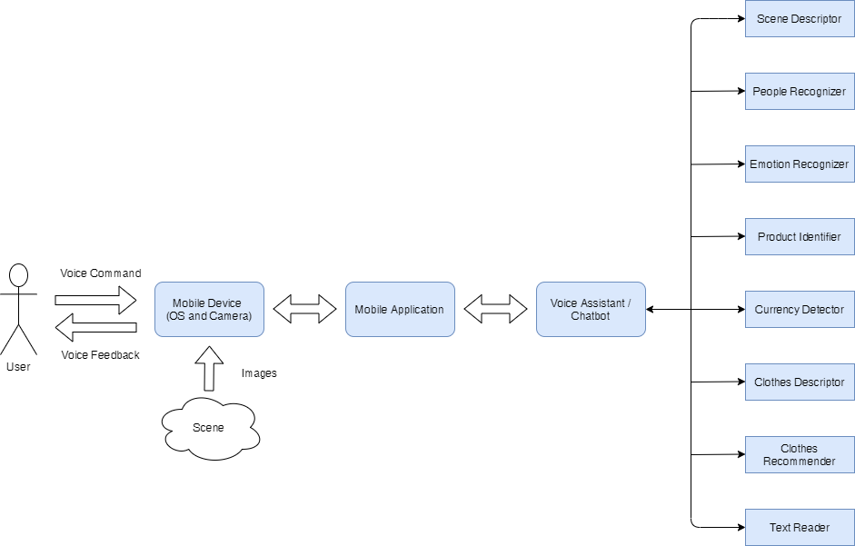
POCKET LENS
SYSTEM DESIGN AND ARCHITECTURE
7

Slide 8
MODULAR DECOMPOSITION
8

Slide 9

MODULAR DECOMPOSITION
MOBILE APPLICATION
Framework: Flutter
Programming Language: Dart
High performance, cross platform applications
Server: Flask
Client Server Architecture for better performance
9

Slide 10

MODULAR DECOMPOSITION
MOBILE APPLICATION
HOME
PAGE
10

Slide 11
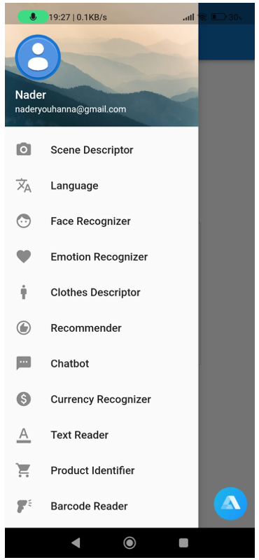
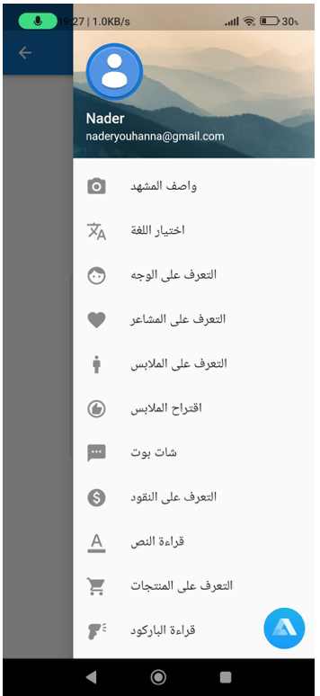
MODULAR DECOMPOSITION
MOBILE APPLICATION
NAVIGATION
Using Side Bar Menu
OR
Using voice commands
11

Slide 12
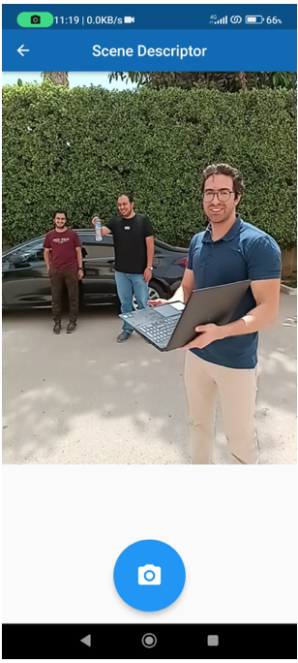
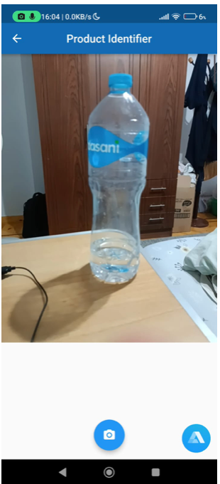
MODULAR DECOMPOSITION
MOBILE APPLICATION
APPLICATION MODULES
12

Slide 13

MODULAR DECOMPOSITION
MOBILE APPLICATION
CHATBOT
Q: What’s the weather like ?
A: (sound) It’s currently sunny and warm
Q: Where is Germany located ?
A: (sound) Germany is situated in central Europe
13

Slide 14
POCKET LENS
SCENE DESCRIPTOR
COCO Dataset
Object Detection and Instant Segmentation using Yolov8
Depth Estimation using Midas
Distance to object
COCO DATASET
YOLO OBJECT DETECTION
MIDAS DEPTH ESTIMATION
DISTANCE TO OBJECT
14

Slide 15
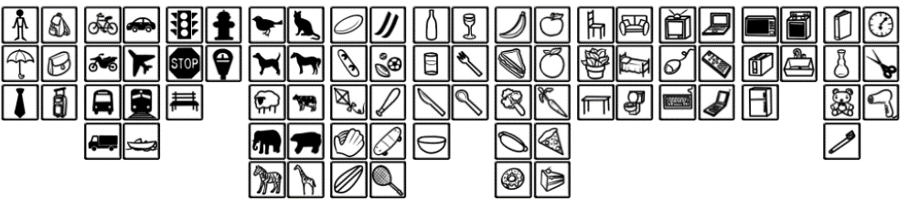
MODULAR DECOMPOSITION
COCO DATASET
Dataset Description
consists of over 200,000 images with more than 80 object categories
Training With COCO dataset
data augmentation
Advantages and limitations
large-scaleو detailed annotationو segmentation masks and bounding boxes
some categories may have fewer instances compared to others.
OBJECTIVES 01
SCENE DESCRIPTOR
15

Slide 16
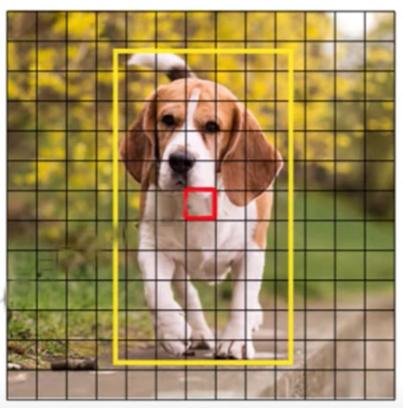
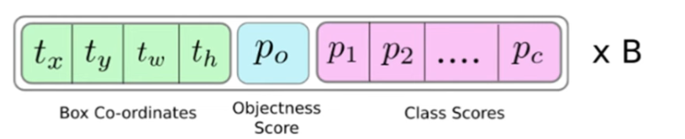
MODULAR DECOMPOSITION
SCENE DESCRIPTOR
YOLOV8 OBJECT DETECTION
Deep learning based algorithm (CNN)
Grid of cells 13x13 or 19x19
Anchor boxes, objectness score, and softmax class scores
Non maxima suppression (NMS)
Use labels, annotations and bounding boxes in minimization Loss Function:
Classification Loss
Bounding Box Regression Loss
Integration of an instant segmentation branch
16

Slide 17
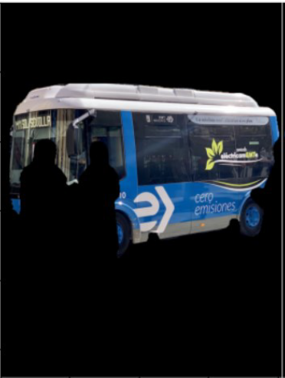
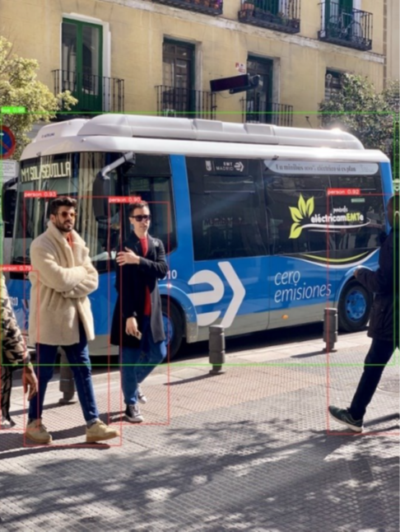
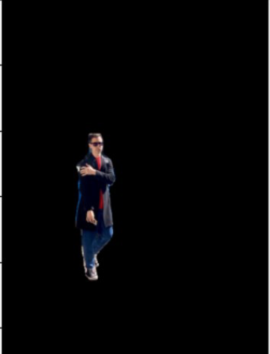
MODULAR DECOMPOSITION
SCENE DESCRIPTOR
YOLOV8 OBJECT DETECTION
17

Slide 18
MODULAR DECOMPOSITION
SCENE DESCRIPTOR
MIDAS DEPTH ESTIMATION
Deep learning-based algorithm
Monocular depth estimation using a single image
Large annotation dataset with RGB - D images
High-resolution --> shows details, loss of context
Low-resolution --> shows context, loss of details
Maintain context and details by training different scales for the same image
Minimize loss function of predicted depth for each px
18

Slide 19
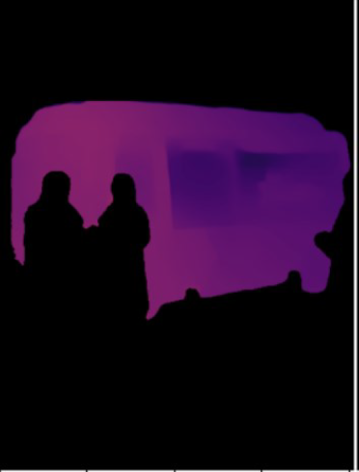


MODULAR DECOMPOSITION
SCENE DESCRIPTOR
MIDAS DEPTH ESTIMATION
19

Slide 20
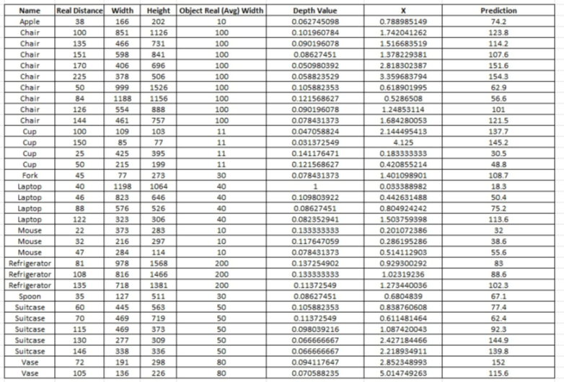
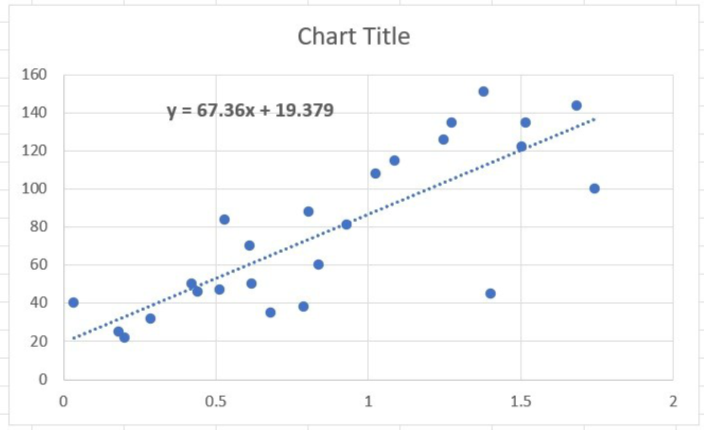
DISTANCE TO OBJECT
MODULAR DECOMPOSITION
SCENE DESCRIPTOR
Heat map conversion to grayscale
Values of grayscale are proportional to distance but not equal
X = (average object height in real life) / (object pixel height in image * grayscale value)
Y = a * X + b, where Y is the true distance from the object (in centimeters), X is the calculated value from the equation above, and "a" and "b" are constants.
Obtaining values of X
Plotting distance estimation and use linear regression
20

Slide 21
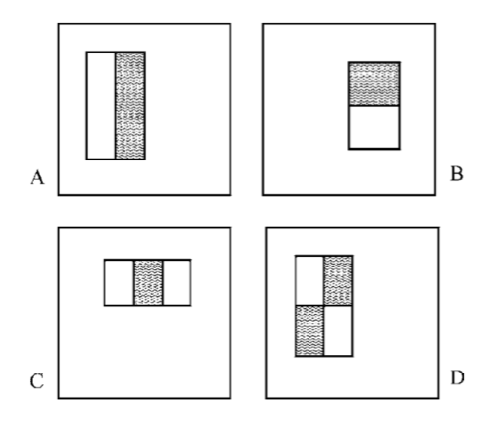
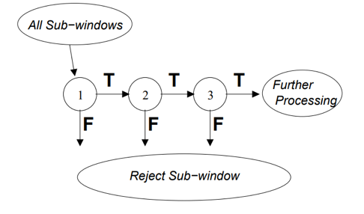
MODULAR DECOMPOSITION
FACE DETECTION
It uses Haar cascades to extract features from an image and train a machine learning model to recognize a face.
Haar features are extracted on 24x24 rectangles.
Adaboost was used to select a number of Haar features.
The selected Haar features forms a strong classifier
It uses a Cascade classifier for rapid detection.
21

Slide 22
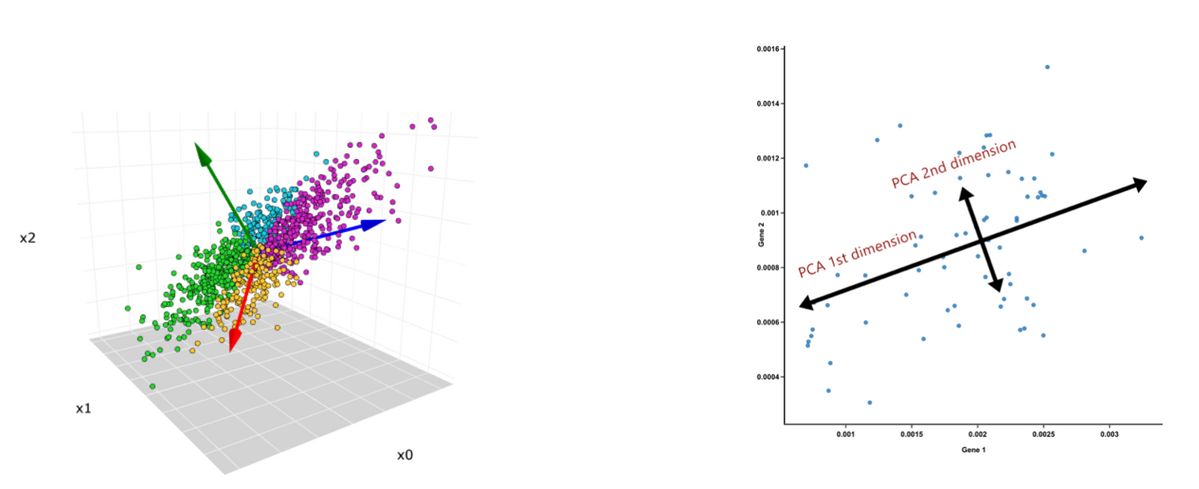
MODULAR DECOMPOSITION
FACE RECOGNITION: EIGENFACES
Uses Principal Component Analysis (PCA)
Training examples are points in the feature space
Select features with greatest variability largest variance
They help distinguish classes the most
22

Slide 23
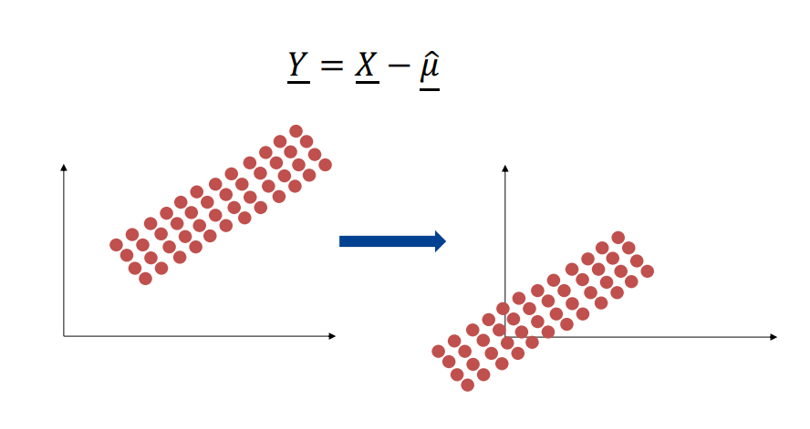
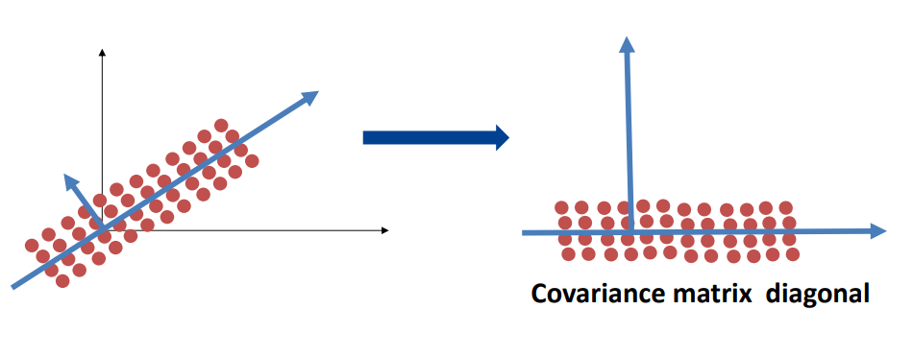
MODULAR DECOMPOSITION
FACE RECOGNITION: EIGENFACES
Translation: Normalize the dataset (transform to zero mean problem)
Rotation: Find the matrix A that transforms it to desired variance
Matrix ofeigenvectors of covariance matrix
23

Slide 24
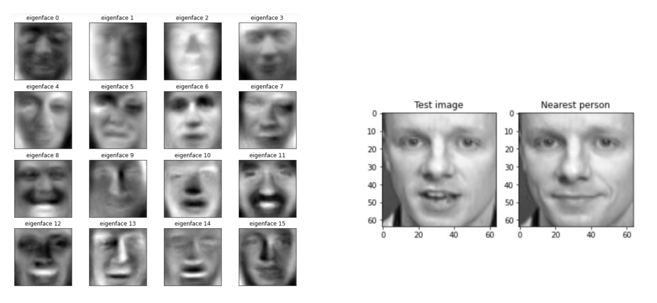
MODULAR DECOMPOSITION
FACE RECOGNITION: EIGENFACES
24

Slide 25
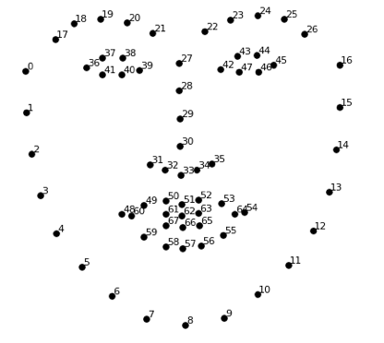
MODULAR DECOMPOSITION
EMOTION DETECTION
Extraction of facial landmarks
-The process extracts 68 facial landmarks on the face = 136 features
The facial landmarks can be analyzed to detect shape of the face, the position and orientation of the eyes, the position of the nose, and the shape of the mouth.
26

Slide 26
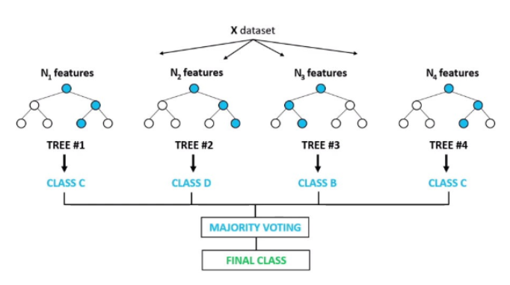
MODULAR DECOMPOSITION
EMOTION DETECTION
The extracted facial landmark are used to predict the emotion
The prediction is done using Random Forest Classifier
Emotions that can be detected are
Fear
Happy
Neutral
Anger
Sadness
Contempt
Disgust
Surprise
27

Slide 27
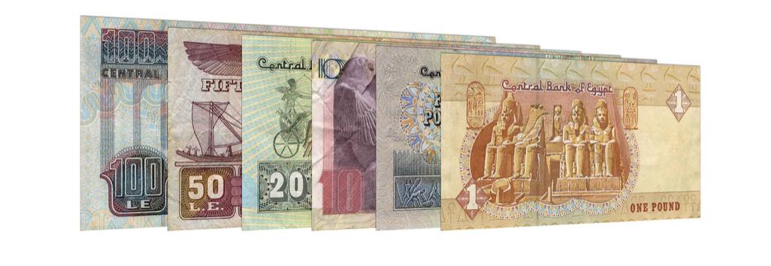
POCKET LENS
CURRENCY RECOGNIZER
Currency recognition model using KNN, histogram, texture, and ORB features
Improves quality of life for visually impaired individuals
Key benefits:
Enhanced autonomy: Enables independent financial management
Increased confidence: Boosts self-assurance in daily tasks and social interactions
Reduced risk of fraud: Accurate identification of currency denominations
Overall impact: Contributes to better quality of life and inclusive society
28

Slide 28
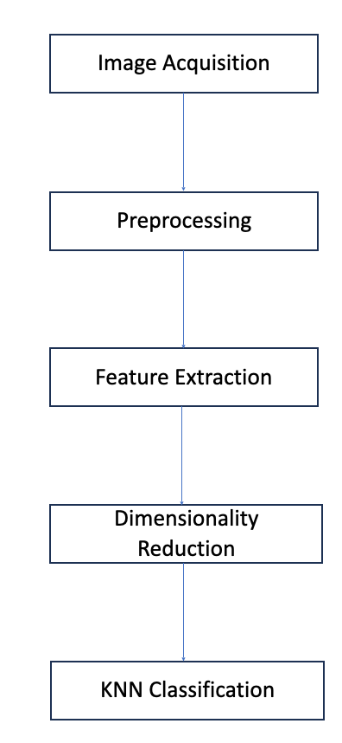
MODULAR DECOMPOSITION
STEP BY STEP PROCESS
CURRENCY RECOGNIZER
Image Acquisition: Capture and collect currency images
Preprocessing: Enhance input images (resizing, denoising, normalization)
Feature Extraction: Extract histogram, texture, and ORB features
Dimensionality Reduction: Transform original feature space into lower-dimensional space using PCA
KNN Classification: Apply k-Nearest Neighbors algorithm for recognition
29

Slide 29
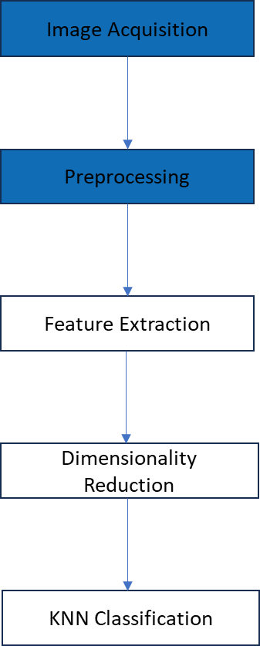
MODULAR DECOMPOSITION
CURRENCY RECOGNIZER
IMAGE ACQUISITION AND DATA PREPROCESSING
Currency images are captured using our application and transmitted for preprocessing and detection in this model
Preparing the input dataset and ensuring images are suitable for feature extraction
Objective: Augment dataset and enhance model robustness for better recognition performance
30

Slide 30
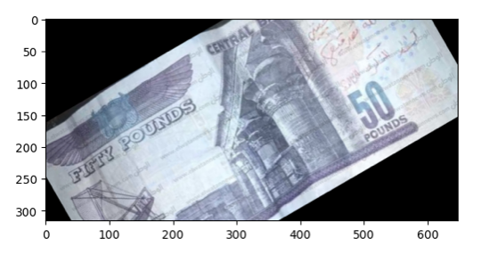
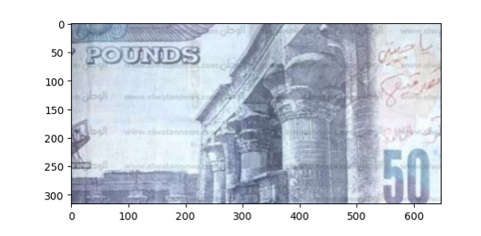
MODULAR DECOMPOSITION
IMAGE ACQUISITION AND DATA PREPROCESSING
CURRENCY RECOGNIZER
Rotation and Scaling
Functions used: rotate(img, angle) and scale(img, scale)
Purpose: Introduce variability in image orientation and size
Rotation: Apply different angles to input images to account for real-world variations
Scaling: Adjust image dimensions to normalize image sizes and improve computational efficiency
31

Slide 31
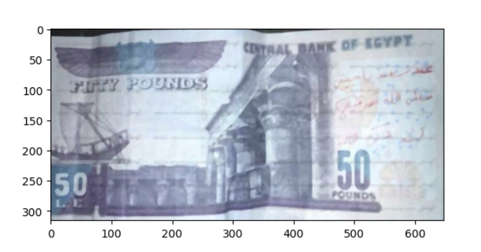
MODULAR DECOMPOSITION
IMAGE ACQUISITION AND DATA PREPROCESSING
CURRENCY RECOGNIZER
Blurring
Function used: blur(img, blur_type)
Purpose: Simulate the effect of out-of-focus images and account for different imaging conditions
Blurring techniques: Average, Gaussian, Median, and Bilateral
Helps improve classifier performance by handling varying degrees of image sharpness
32

Slide 32
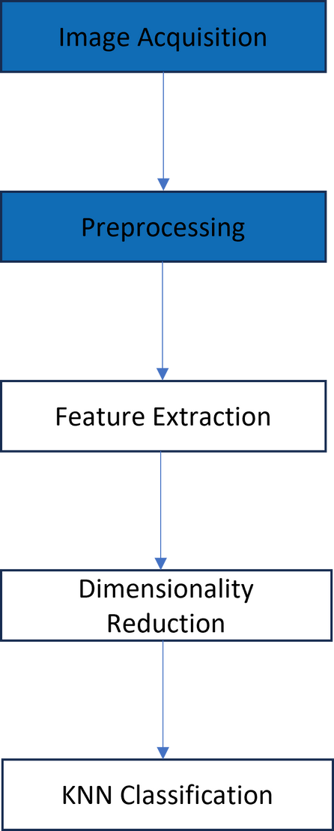
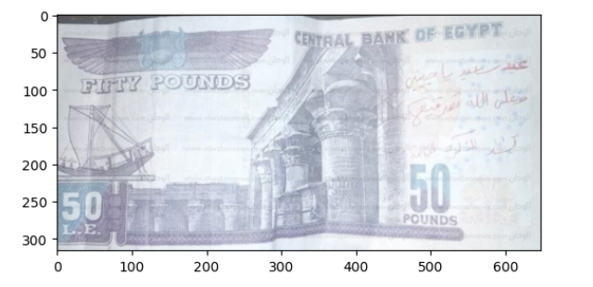
MODULAR DECOMPOSITION
IMAGE ACQUISITION AND DATA PREPROCESSING
CURRENCY RECOGNIZER
Lighting Adjustment
Function used: lighting(img, lighting_type)
Purpose: Adapt to different lighting conditions and address illumination variations in input images
Lighting adjustments: Brightness, Contrast, Gamma Correction, Histogram Equalization
Increases model robustness by handling diverse lighting scenarios encountered in real-world applications
33

Slide 33
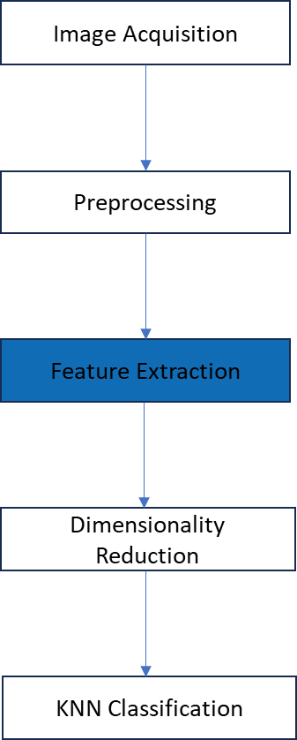
MODULAR DECOMPOSITION
CURRENCY RECOGNIZER
FEATURE EXTRACTION
Third stage of the currency recognition model for visually impaired people
Importance of generating a comprehensive feature vector to represent currency images
Combine histogram, texture, and ORB features to create a comprehensive feature vector
Utilize feature vector as input for the k-Nearest Neighbors (kNN) algorithm during classification
Objective: Accurately classify different currency denominations using extracted features
34

Slide 34
MODULAR DECOMPOSITION
FEATURE EXTRACTION
CURRENCY RECOGNIZER
Histogram Features
Extract color information using histograms
Graphical representation of color value distribution in an image
Computed for each color channel (e.g., Red, Green, and Blue)
Concatenate histograms to form a single feature vector
ORB Features
Oriented FAST and Rotated BRIEF (ORB) algorithm for keypoint and descriptor extraction
Invariant to rotation, scale, and illumination changes
Identify distinctive points (keypoints) in images and compute binary descriptors
Capture local patterns around keypoints for classification
35

Slide 35
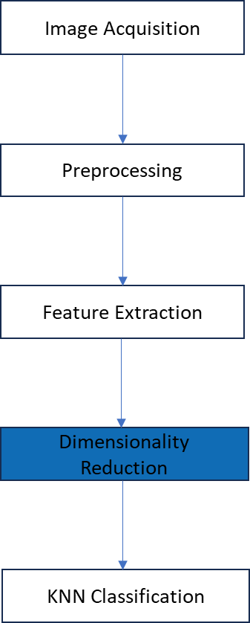
MODULAR DECOMPOSITION
DIMENSIONALITY REDUCTION
CURRENCY RECOGNIZER
Dimensionality reduction using Principal Component Analysis (PCA)
Address issues of redundant information and computational complexity
Key steps:
1. Standardize feature data
2. Determine optimal number of principal components
3. Apply PCA with optimal number of components
4. Update feature vector
Lower-dimensional representation used as input for kNN algorithm during classification stage
37

Slide 36
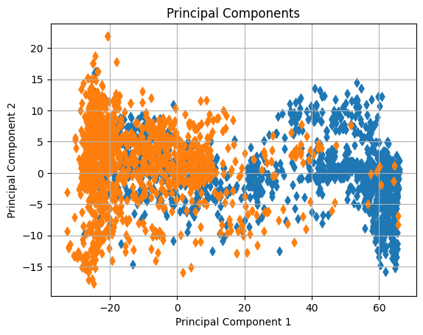
MODULAR DECOMPOSITION
DIMENSIONALITY REDUCTION
CURRENCY RECOGNIZER
The difference between 5 EGP and 10 EGP components value after PCA.
38

Slide 37
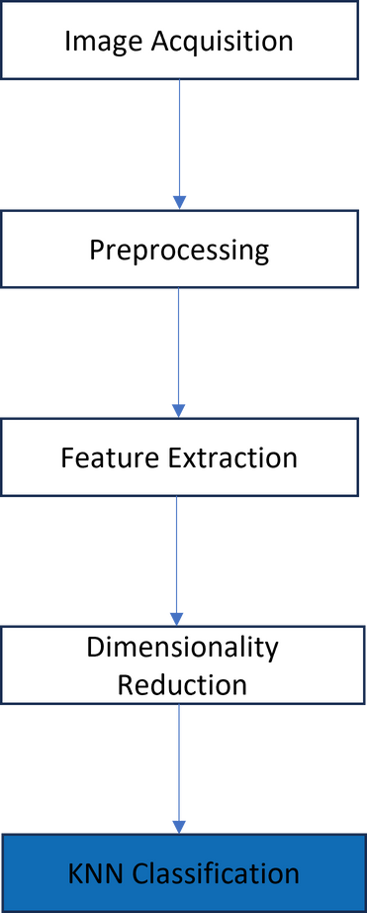
MODULAR DECOMPOSITION
KNN CLASSIFICATION
CURRENCY RECOGNIZER
Final stage: Classification using k-Nearest Neighbors (kNN) algorithm
Key steps:
1.Training kNN classifier
2.Choosing value of 'k’
3.Distance metric
Classification: Calculate distance between input image's feature vector and training dataset, assign majority class among 'k' nearest neighbors
Outcome: Accurate recognition of different currency denominations for visually impaired users
39

Slide 38
POCKET LENS
CLOTHES DESCRIPTOR
DATASET PREPARATION
MASK R-CNN
TEXTURE DETECTION
COLOR DETECTION
40

Slide 39
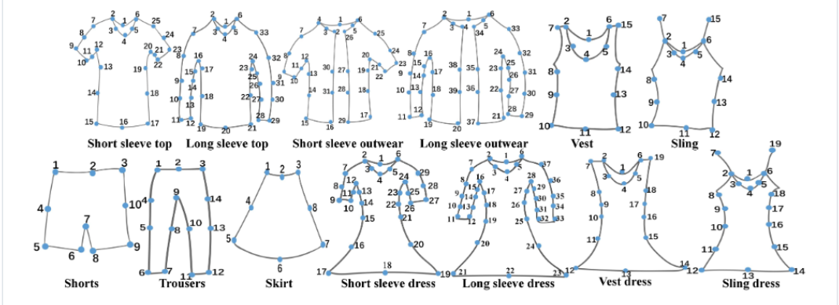
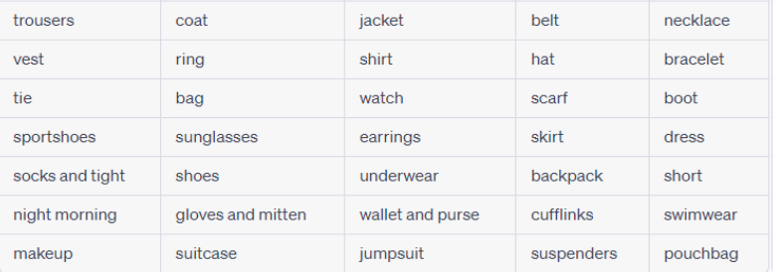
MODULAR DECOMPOSITION
CLOTHES DESCRIPTOR
•DeepFasion2 Dataset
•Clothing Detection E-commerce Dataset
•Custom Texture Dataset
•Dataset Annotation
41

Slide 40
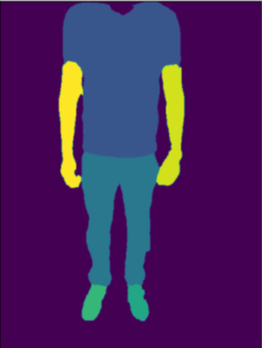
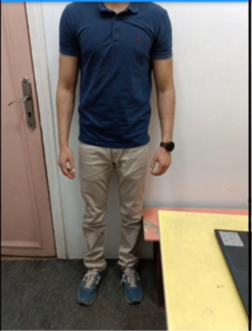
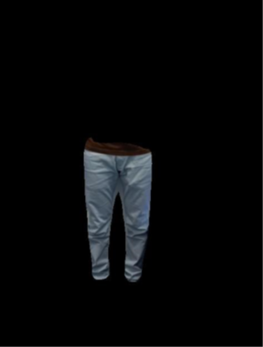
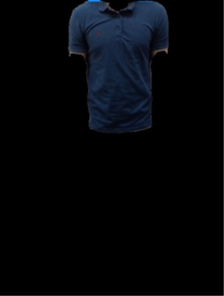
MODULAR DECOMPOSITION
CLOTHES DESCRIPTOR
MASK R-CNN
Region Proposal Network (RPN)
Same concept as yolo
Mask Head generates binary mask for each anchor box (Pixel-Level Segmentation)
Minimize loss function
Classification Loss
Bounding Box Regression Loss
Segmentation Mask Loss
42

Slide 41
TEXTURE DETECTION
MODULAR DECOMPOSITION
CLOTHES DESCRIPTOR
Data Loading and Preprocessing
Loading
Resizing
Split Shuffling
Feature Selection and Extraction
GLCM (Homogeneity, Energy, Entropy, Contrast, Coorelation)
Daisy (Local Descriptors, scale and orientation invariance)
PCA
Standardization
Model Selection and Training
KNN
ANN
SVM
Random Forest
Performance Analysis
DATA
FEATURES
MODEL
PERFORMANCE
43

Slide 42
MODULAR DECOMPOSITION
CLOTHES DESCRIPTOR
COLOR DETECTION
•Process segmented Image
•Extract most 3 dominant color
•Calculate distance to the ten most principal colors
•Choose colorswith minimum distance
44

Slide 43
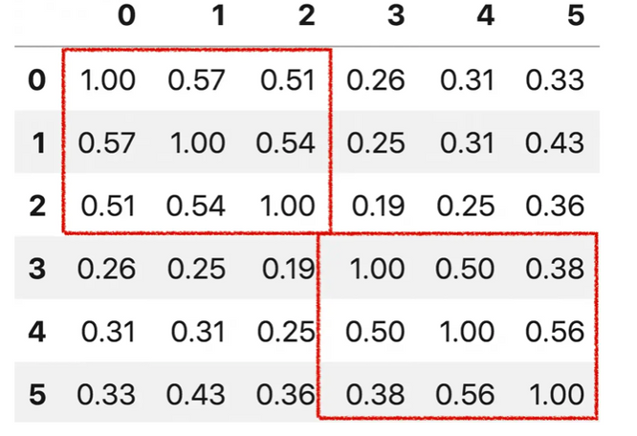
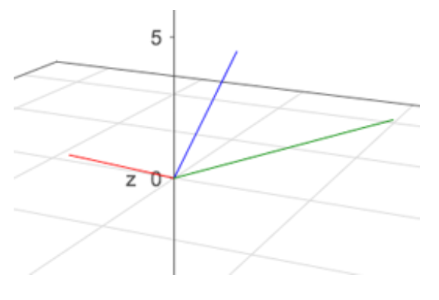
MODULAR DECOMPOSITION
APPAREL RECOMMENDER
Recommend to the user an outfit based on their preference
Also follows some generic fashion rules
TF-IDF is used to vectorize the user’s wardrobe
-Results are 3D vectors since three
features were used
Cosine similarity matrix is used to get the closest outfit.
The outfit must follow some rules
E.g. Wearing a short and a blazer together is not recommended.
45

Slide 44
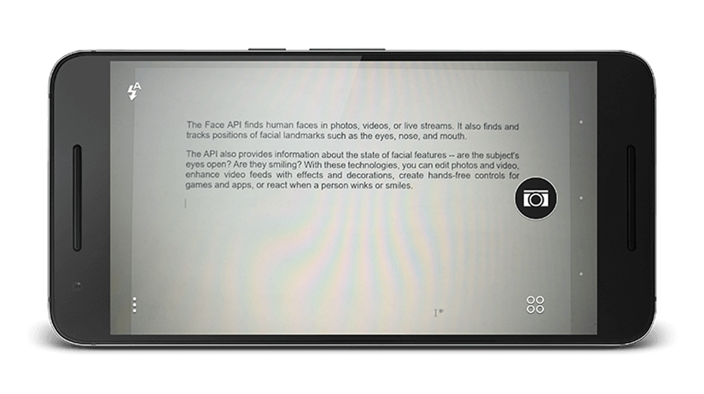
POCKET LENS
TEXT READER
Text recognition module for visually impaired individuals
Improves quality of life for visually impaired users
Adaptable module recognizes various languages, fonts, sizes, and orientations
Versatile tool for enhancing accessibility in diverse contexts
Powerful solution for breaking down barriers and fostering a more inclusive society
46

Slide 45
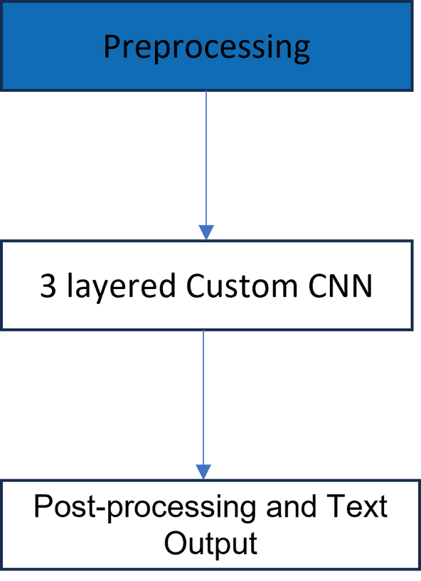
MODULAR DECOMPOSITION
PREPROCESSING
TEXT READER
Stage 1: Preprocessing
Objective: Prepare EMNIST dataset for training 3-layered CNN architecture
Steps:
Removing N/A Labels: Eliminate instances with missing or not applicable character labels
Normalization: Normalize pixel values to a range of 0 to 1 for improved numerical stability
Data Augmentation: Apply rotation and lighting adjustments to enhance model robustness
Reshaping & Grayscale Conversion: Convert images to grayscale and reshape to match CNN input dimensions
Dataset Splitting: Divide preprocessed dataset into training, validation, and testing subsets using stratified sampling
Outcomes:
Clean, accurate data for model training
Improved model resilience to various transformations and real-world scenarios
47

Slide 46
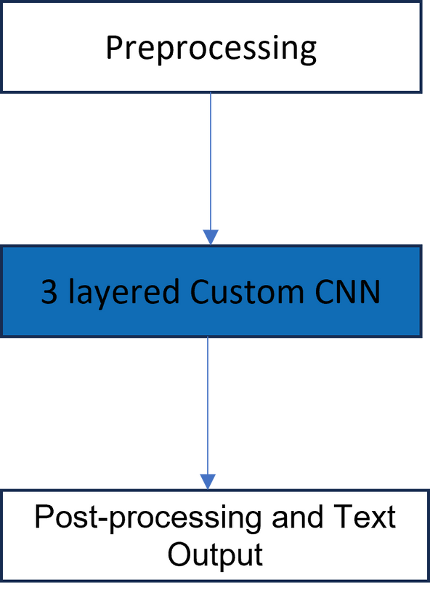
MODULAR DECOMPOSITION
3 LAYERED CUSTOM CNN
TEXT READER
Stage 2: 3 layered Custom CNN
EMNISTNet CNN Architecture
Custom CNN architecture for character recognition using PyTorch framework
Components:
Convolutional Layers: Detect and combine low-level to complex features
conv1, conv2, conv3 with increasing output channels
Batch Normalization Layers: Improve convergence and generalization
bnorm1, bnorm2, bnorm3 applied after each convolutional layer
Fully Connected Layers: Form abstract representation and classify images
fc1, fc2, fc3 with decreasing output sizes
Dropout Layers: Prevent overfitting (dropout rate: 0.5)
dropout1 and dropout2 after fc1 and fc2
48

Slide 47
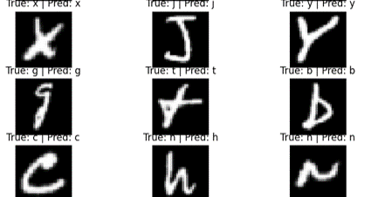
MODULAR DECOMPOSITION
3 LAYERED CUSTOM CNN
TEXT READER
Stage 2: 3 layered Custom CNN
Activation Functions and Training Process
Activation function: Replace ReLU with Leaky ReLU to avoid "dying ReLU" problem
Training process:
Train for 30 epochs using Adam optimizer (learning rate: 0.0005) and ReduceLROnPlateau scheduler
Minimize categorical cross-entropy loss with backpropagation
Record training and test errors and losses for performance evaluation and model selection
Outcome: Robust character recognition model with improved convergence and reduced overfitting
49

Slide 48
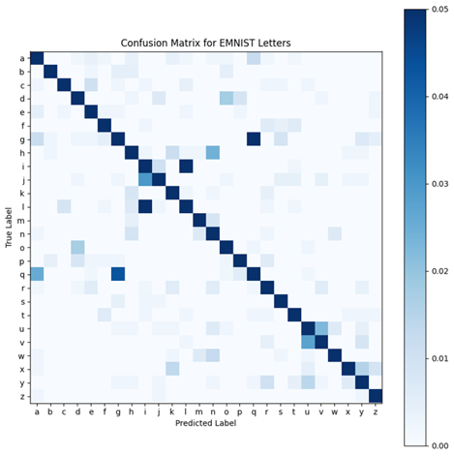
MODULAR DECOMPOSITION
3 LAYERED CUSTOM CNN
TEXT READER
Stage 2: 3 layered Custom CNN
26x26 grid plot: Rows are true labels, columns are predicted labels, color indicates prediction proportion
Ideal classifier: Diagonal dark blue cells (high correct predictions), light blue cells elsewhere (low incorrect predictions)
50

Slide 49
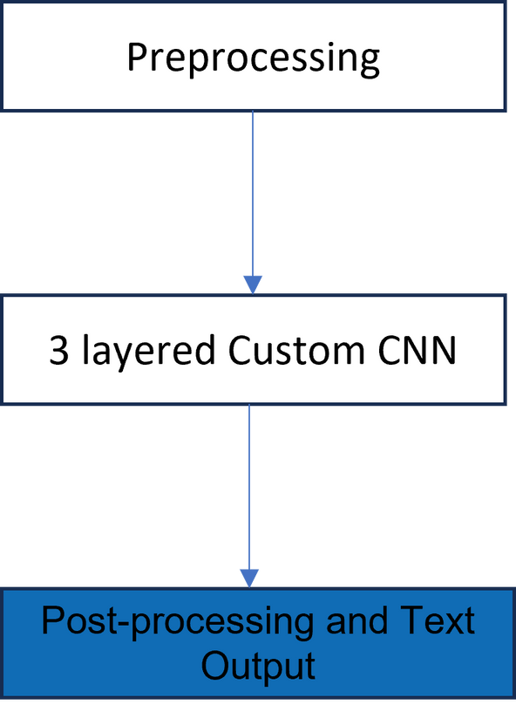
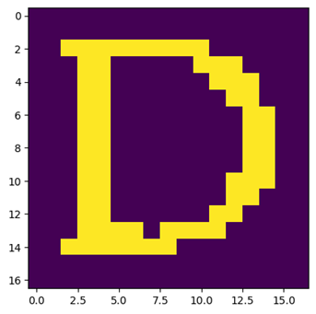
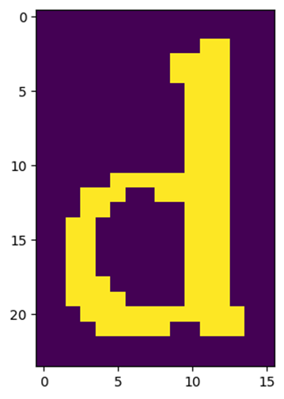
MODULAR DECOMPOSITION
3 LAYERED CUSTOM CNN
TEXT READER
•Stage 3: Post-processing and Text Output
Objective: Predict characters from document images using trained CNN model
Key steps:
Preprocess images
Add padding
Segment images into lines and characters
Skeletonize and resize characters
Recognize characters and extract text
51

Slide 50

MODULAR DECOMPOSITION
PRODUCT IDENTIFIER
Product identification and detection algorithm
Two cascaded CNN was to detect and identify the product.
First CNN detects retail products based
Second CNN detects the logo retail products
52

Slide 51



SYSTEM TESTING AND VERIFICATION
SCENE DESCRIPTOR
53

Slide 52


SYSTEM TESTING AND VERIFICATION
CLOTHES DESCRIPTOR
54

Slide 53
SYSTEM TESTING AND VERIFICATION
CURRENCY RECOGNITION
Evaluate k-NN classifier performance for various 'k' values and distance metrics
K = 3
K = 5
K =7
91% accuracy with Euclidean distance
89% accuracy with Hamming distance
92% accuracy with Euclidean distance
89% accuracy with Hamming distance
93.5% accuracy with Euclidean distance
90% accuracy with Hamming distance
Best performing combination:
k = 7 with Euclidean distance metric (93.5% accuracy)
55

Slide 54

SYSTEM TESTING AND VERIFICATION
TEXT READER
•Preprocessed EMNIST dataset
•Trained model for 25 iterations
•Achieved 93.5% accuracy
•Confusion due to similar letter shapes (e.g., "v" and "r", "g" and "q")
•Model performs well overall, recognizing majority of characters
56

Slide 55

SYSTEM TESTING AND VERIFICATION
FACE
DETECTION
57

Slide 56


SYSTEM TESTING AND VERIFICATION
FACE
RECOGNITION: EIGENFACES
Datasets:
Olivetti (95% accuracy) (40 classes)
LFW (Bad accuracy) (1473 classes)
Our own images
58

Slide 57

SYSTEM TESTING AND VERIFICATION
FACE
RECOGNITION: EIGENFACES
59

Slide 58

SYSTEM TESTING AND VERIFICATION
EMOTION
DETECTION
The model was trained and tested using the Cohn-Kanade (CK and CK+) Dataset.
The system was able to achieve a real-time accuracy rate of 77% in detecting eight different emotions.
60

Slide 59
SYSTEM TESTING AND VERIFICATION
PRODUCT IDENTIFIER
The original dataset was divided 85% training and 15% testing.
The model reach an accuracy of 75%
61

Slide 60
POCKET LENS
LIMITATIONS
Overcoming Computational Challenges in System Development: Dealing with Limited Power and Large Datasets
Addressing Dataset Limitations and Real-World Performance: Optimizing System Development for Valuable Insights
Overcoming Challenges in Obtaining Feedback from Visually Impaired and Blind Individuals: Navigating Limited Accessibility and Engagement
62

Slide 61
POCKET LENS
FUTURE WORK
IMPROVING PRODUCT RECOGNITION FOR VISUALLY IMPAIRED USERS
ENHANCING APPLICATION FUNCTIONALITY
There is an area for improvement in the product identifier module, as accurately recognizing retail products.
Additionally, expanding the application's functionality to include a complete virtual assistant would be a significant improvement.
BY CLAUDIA ALVES
Thesis Defense Presentation Template
63

Slide 62
CONLUSION
Creating a machine learning system to assist visually impaired individuals presented both challenges and rewards. Overcoming obstacles such as limited computing power and dataset diversity, we successfully developed a reliable tool that has had a profound impact on the lives of people worldwide.
64

Slide 63


Slide 64
POCKET LENS
THANK YOU
Any questions?
65

